Slide 1
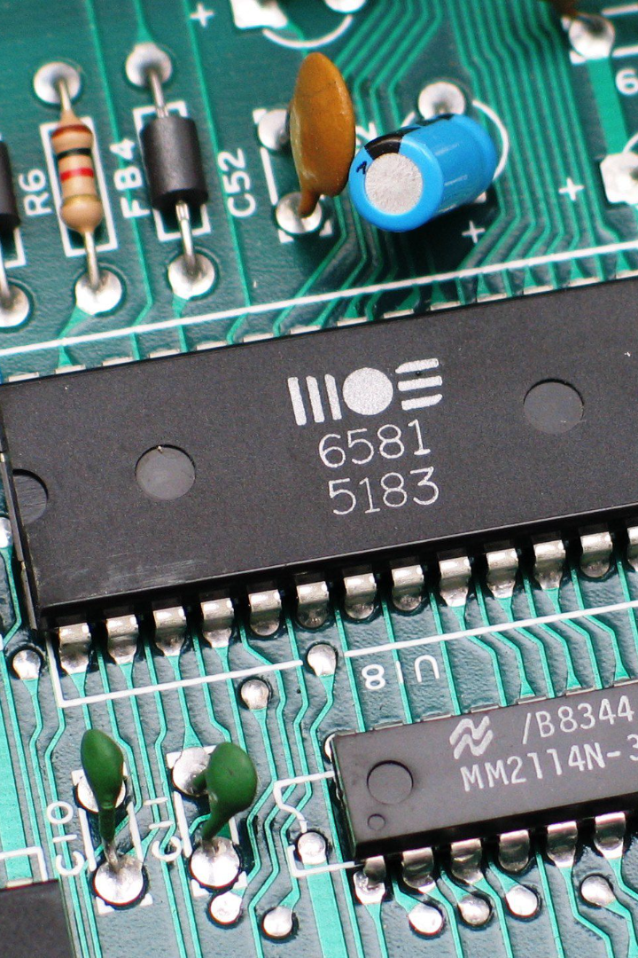


Introduction to Digital Logic Design
Explore the fundamental concepts of digital logic design, including latch and flip-flop circuits, shift registers, and asynchronous sequential circuits.
Anusha Amar

Slide 2

NAND-based SR Latch
1
Working Principle 🧠
2
Signal Flow 📶
Discover the inner workings of the basic latch that forms the foundation of many digital circuits.
Understand how inputs and outputs propagate through the NAND gates to latch and store data.

Slide 3
Flip-Flops: SR, D, JK, T, Master-Slave
SR Flip-Flop
D Flip-Flop
JK Flip-Flop
Learn about the set-reset flip-flop and its applications in memory storage.
Explore the D flip-flop, which is used as a data storage element in sequential circuits.
Discover the versatility of the JK flip-flop and its applications in digital systems.

Slide 4
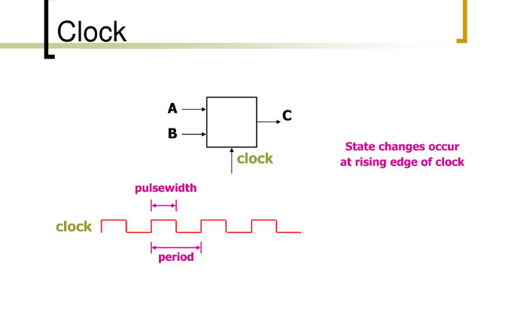

Triggering of Flip-Flops
Positive Edge-Triggered
Negative Edge-Triggered
Examine how flip-flops are triggered by the rising edge of a clock signal.
Learn how flip-flops can be triggered by the falling edge of a clock signal.

Slide 5

JK FF HDL Implementation: Behavioural-Level
1
Design Specification
Define the required behavior of a JK flip-flop using a hardware description language.
2
Truth Table
Construct the truth table to represent the inputs and outputs of the JK flip-flop.
3
Simulation
Simulate the JK flip-flop design to verify its functionality before implementation.

Slide 6
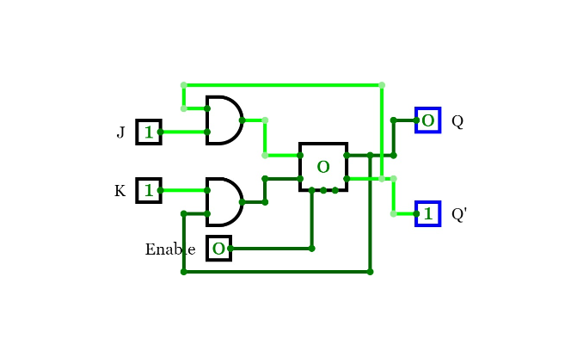
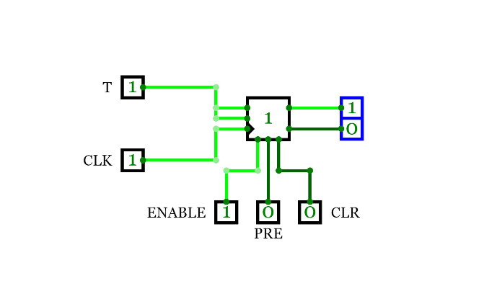
Flip Flop Conversions
SR to JK
JK to T
Learn how to convert a set-reset flip-flop into a JK flip-flop.
Discover the process of converting a JK flip-flop into a T flip-flop.

Slide 7
Shift Registers using D Flip-flops
SISO
SIPO
Implement a D flip-flop based Shift In Shift Out (SISO) register to shift data in and out.
Create a D flip-flop based Shift In Parallel Out (SIPO) register to parallelize shifted data.
PISO
PIPO
Explore the Shift Parallel In Shift Out (PISO) register using D flip-flops to convert parallel data into a serial stream.
Learn about the implementation of a Parallel In Parallel Out (PIPO) register with D flip-flops.

Slide 8
D-Flip Flop based SISO Shift Register: Behavioural-Level
Shift 1
Hold
Shift 0
Hold
Shift 1
Load
Gain insight into the behavioral-level implementation of a D flip-flop based Shift In Shift Out (SISO) shift register.

Slide 9

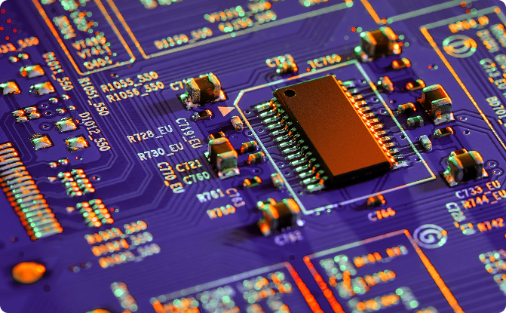
Implementation of Asynchronous Sequential Circuits
Clock Signal
Interconnections
Understand the role of the clock signal in synchronizing the operation of sequential circuits.
Learn how to connect flip-flops and other components to design asynchronous sequential circuits.

